Slide 1
An overview for Boxify Sales Project
-By Shivani Patnaik

Slide 2
Effective inventory management is essential for businesses to maintain optimal stock levels, minimize carrying costs, and meet customer demand.
Introduction

Slide 3
Objective
Analyze the provided sales dataset to understand sales trends, stock levels, and product performance.
Identify popular products, low-stock items, and sales patterns over time.
Generate actionable recommendations for improving inventory management efficiency.

Slide 4
Tools & Technology used
Python
Pandas
NumPy
Matplotlib
Plotly
Statsmodels
Jupyter Notebook

Slide 5

Features
Data Collection
Data Cleaning & Preparation
Exploratory Data Analysis
Data Visualization
Inventory Insights
Recommendation
Documentation
Reporting

Slide 6
Project Visualization

Slide 7
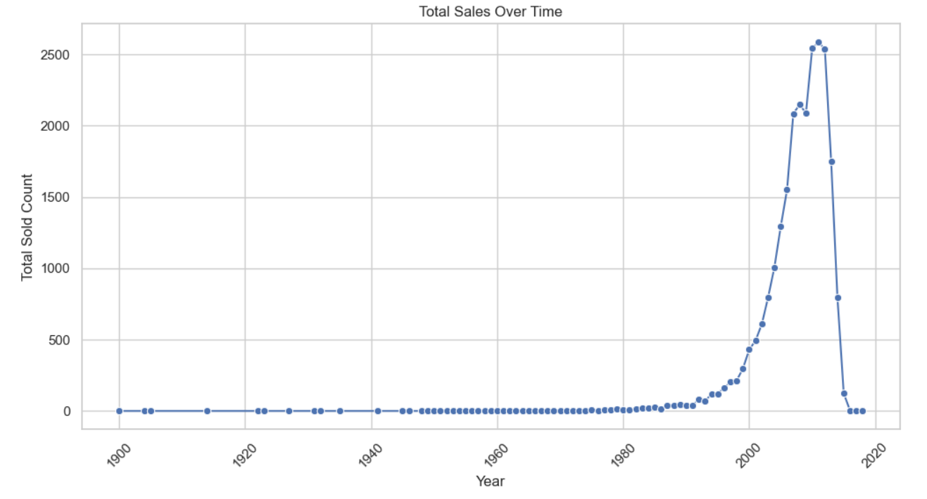

Slide 8
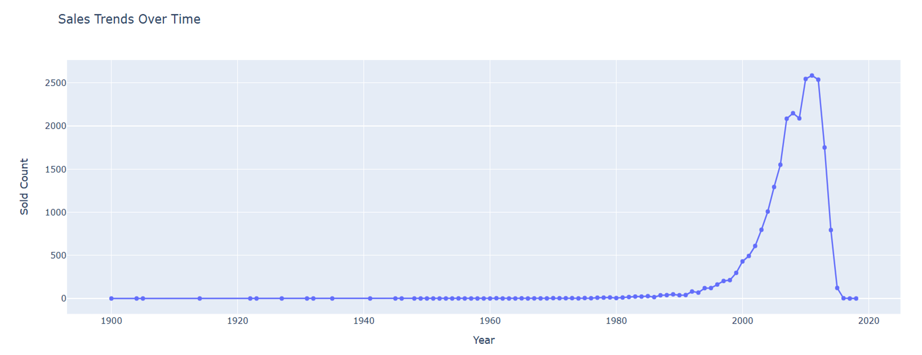

Slide 9
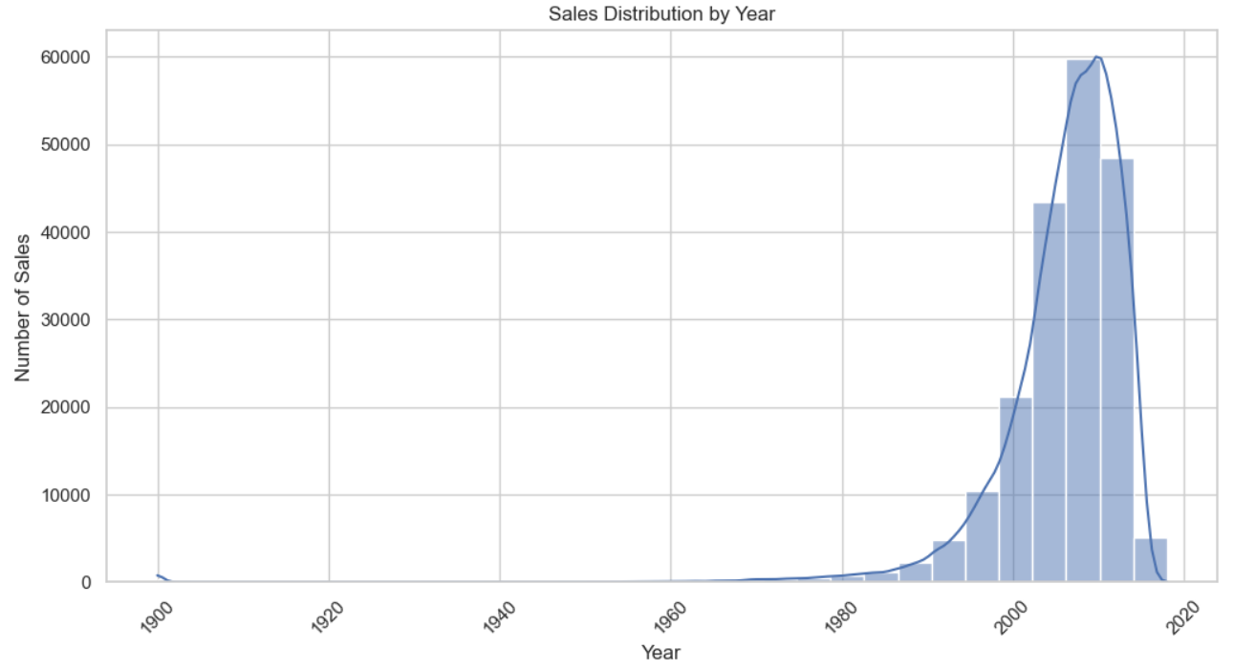

Slide 10
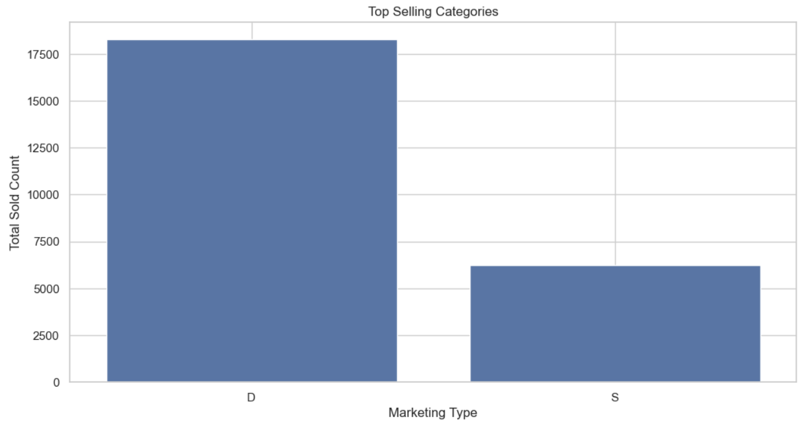

Slide 11
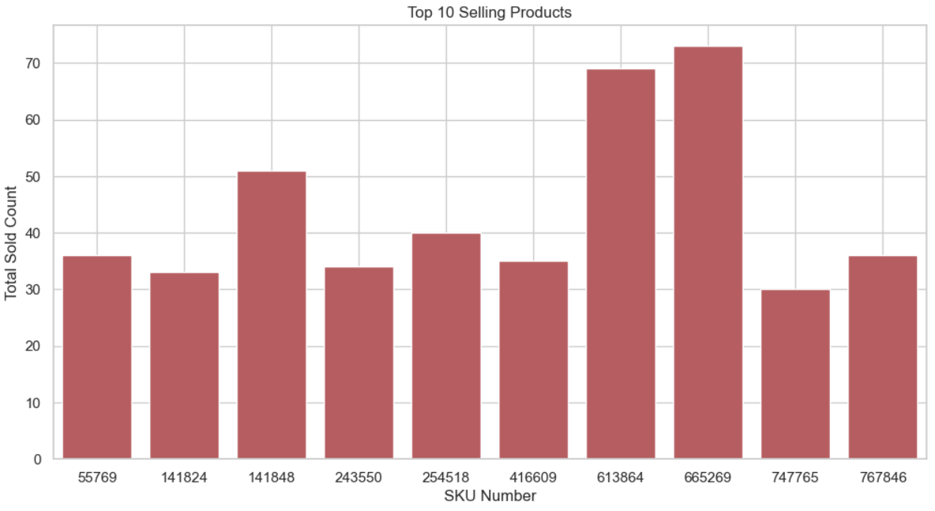

Slide 12
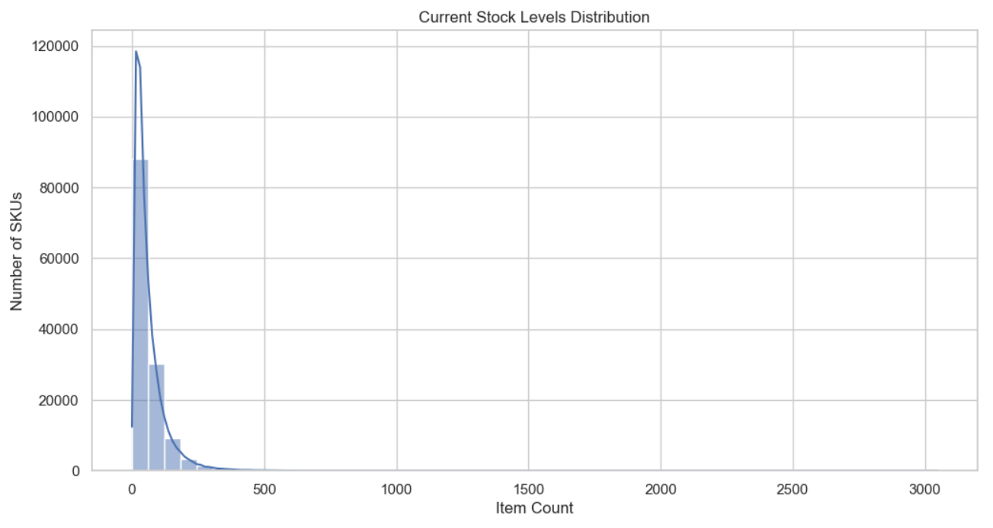

Slide 13
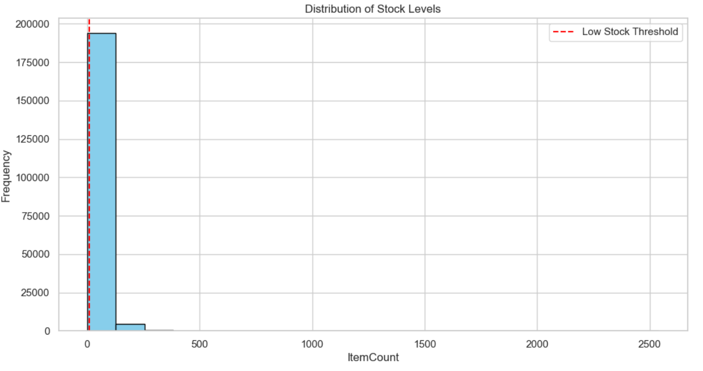

Slide 14
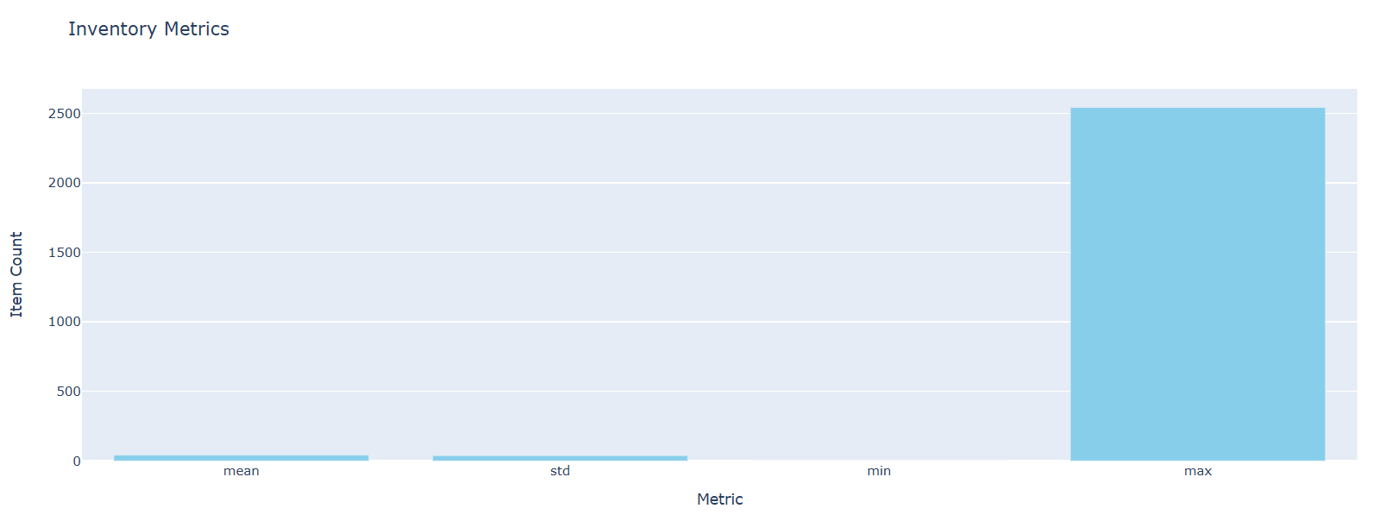

Slide 15
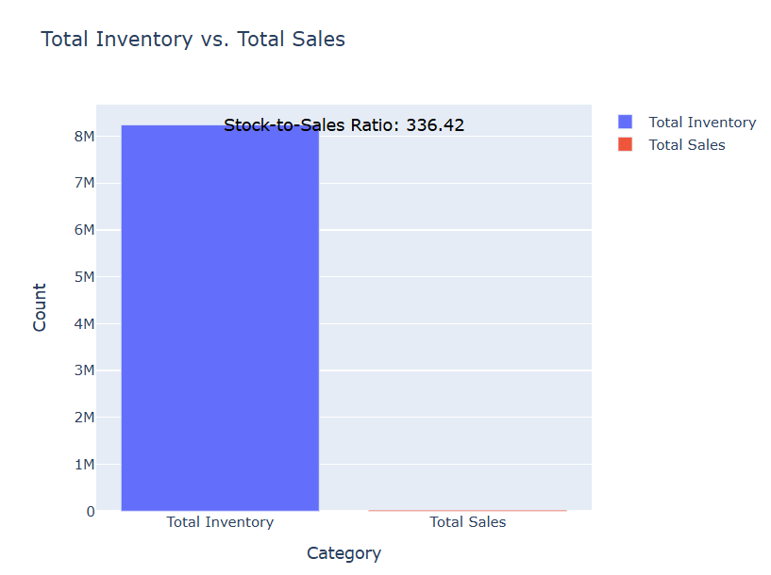

Slide 16
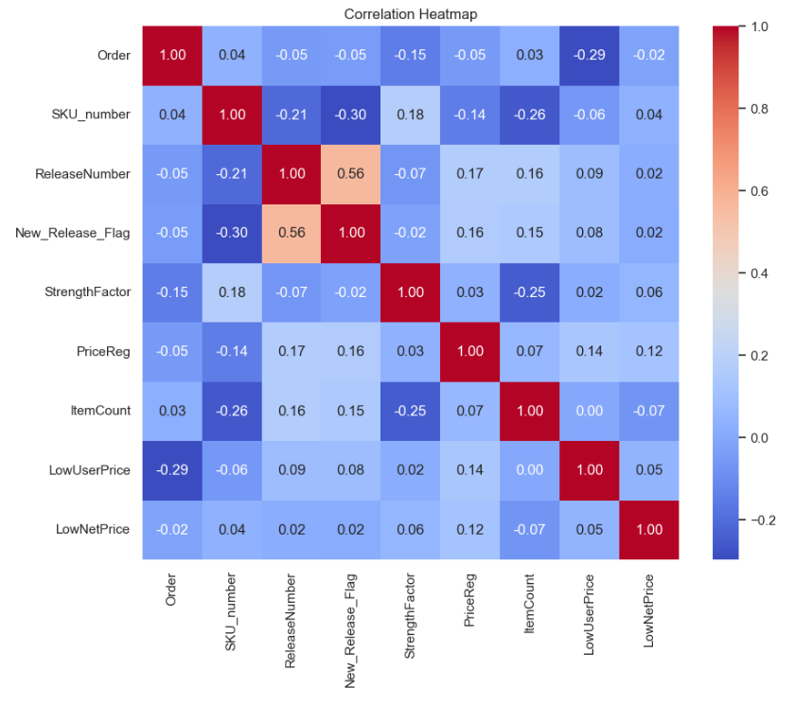

Slide 17
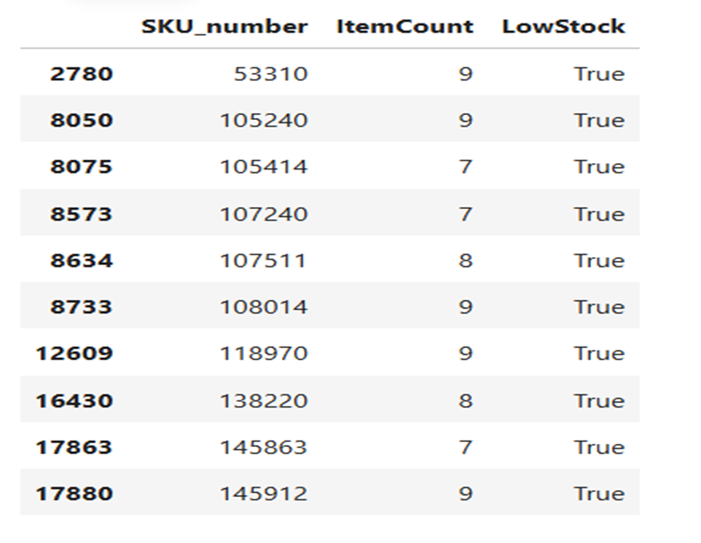

Slide 18
Inventory Insights
The Key Performance Indicators
Inventory Turnover : 591.27
Stock-to Sales Ratio : 336.42
Reorder Points : 1127.40

Slide 19
Recommendations
1. Accurate Demand Forecasting
Historical Sales Data
Advanced Methods
2. Demand-Driven Inventory Management
Dynamic Adjustments
Real-Time Integration
3. Optimization of Stock Levels
Sales Pattern Analysis
Resource Reallocation

Slide 20
Recommendations
4. Just-in-Time (JIT) Inventory
Reduce Excess Inventory
Timely Replenishment
5. Supplier Collaboration
Enhance Relations
Reduce Lead Times
6. Regular Monitoring of Metrics
Track Metrics.
Corrective Actions
7. Invest in Technology
8. Continuous Improvement

Slide 21

Thank you

